Slide 1
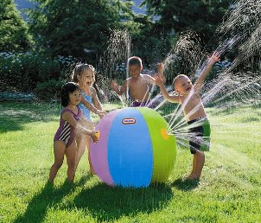
WORKING TOGETHER
FOR KIDS MENTAL HEALTH

Slide 2
IMPLEMENTATION
Working Together for Kids Mental Health is being implemented in four communities during 2010/11:
  Belleville
  Haliburton
  Niagara
  Sudbury

Slide 3
ANTICIPATED OUTCOMES
Enhanced understanding of how to reduce stigma
Enhanced cross sector collaboration with child and youth mental health
A more consistent understanding of mental health needs across sectors
Enhanced ability for cross sector partners to identify and refer children and youth appropriately
Identification of effective strategies to meet a range of mental health needs
Increased use of effective practices (e.g. tools and protocols) to support a service delivery system that is based on needs

Slide 4
KEY ACTIVITIES
providing orientation and training to professionals across health, education and children’s services sectors on the use of Identification Tools and Needs Assessment Tools, mental health awareness and privacy/sharing of information
examining the use of/impact of existing and new tools on decisions
identifying/implementing best or promising practices and protocols to support collaboration across sectors.

Slide 5
FUNDING SUPPORTS
Funding supports are being provided to the participating MCYS-funded agencies /communities to help offset service impacts resulting from participating in training, exploring the use of new tools, and data collection activities during 2010/11.

Slide 6
INFORMATION PROCESS
Information is being gathered throughout 2010/11 from work in the four communities, as well as across the entire sector (i.e. complementary work currently under development), which will inform policy work and provide the foundation for the development and implementation of provincial standards and expectations. This will include decisions regarding the future use of provincially licensed tools (e.g. Brief Child and Family Phone Interview (BCFPI) and Child and Adolescent Functional Assessment Scale (CAFAS).

Slide 7
TIMELINES
The directions and recommendations resulting from Working Together for Kids Mental Health (four communities and complementary work) are targeted for the end of the current fiscal year (March 31, 2011).

Slide 8
PARTNERSHIP TRAINING AND ASSESSMENT TIMELINES

Slide 9
PROJECT MANAGEMENT

Slide 10
DATA ENTRY AND
COLLECTION TIMELINES

